Slide 1
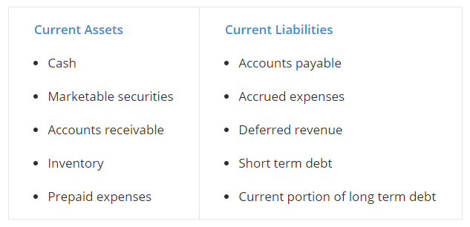

$$Working capital=Current assets −Current liabilities$$
$$Current ratio= \frac{Current asset}{Current liabilities}$$
$$Quick ratio= \frac{Cash and marketable securities and accounts receivable}{Current liabilities}$$

